Slide 1
LJ-V7000 Get/Set Settings via DLL
KEYENCE
6/17/2014

Slide 2
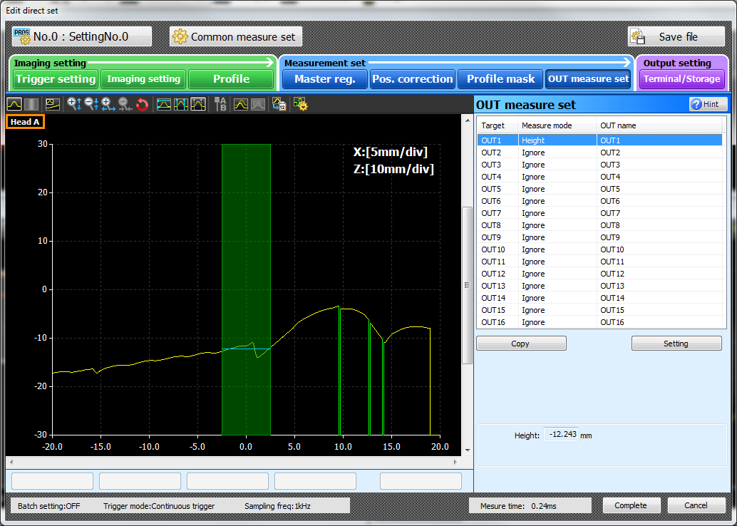
Measurements in LJ-Navigator2
16 Programs can be saved on the LJ-V7000 controller
16 Measurements are saved within each program

Slide 3
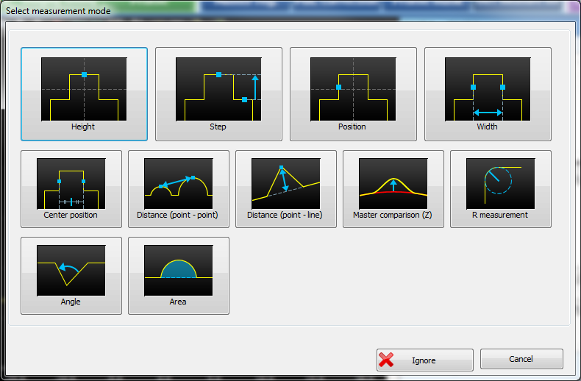
Measurements Modes
Note how these measurement modes line up with 2nd byte on the following slide.

Slide 4
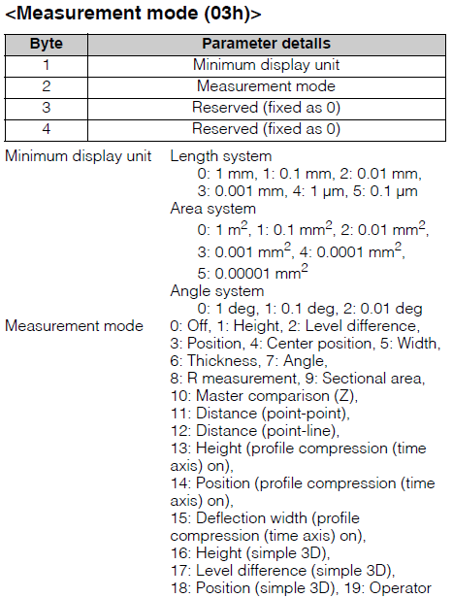
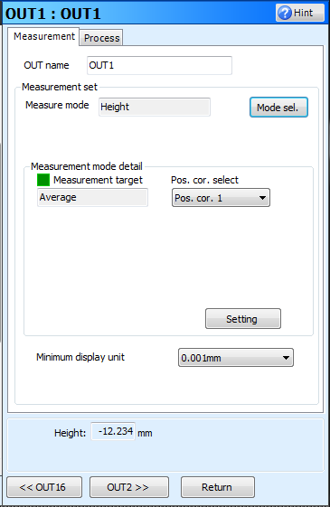
Measurement Settings
Every measurement contains a variety of additional parameters such as Measurement Mode, Target, Tolerances, etc.
Pg. 72

Slide 5
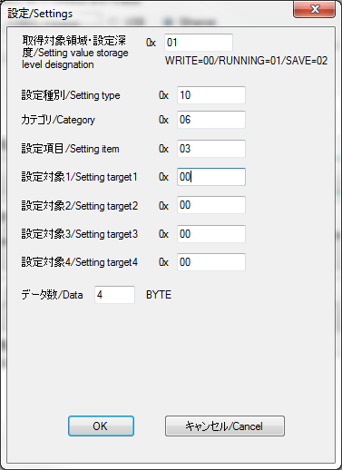
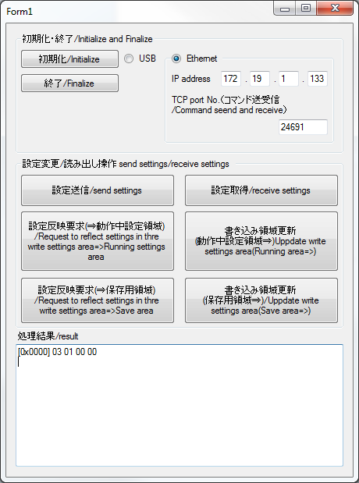
Corresponding DLL Results
1
2
3
4
5
*Results to be elaborated upon in following slides.

Slide 6
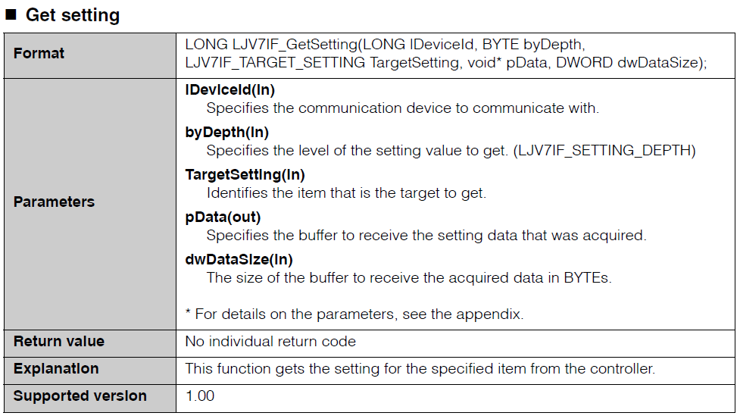
Function To Get Settings
Pg. 33

Slide 7
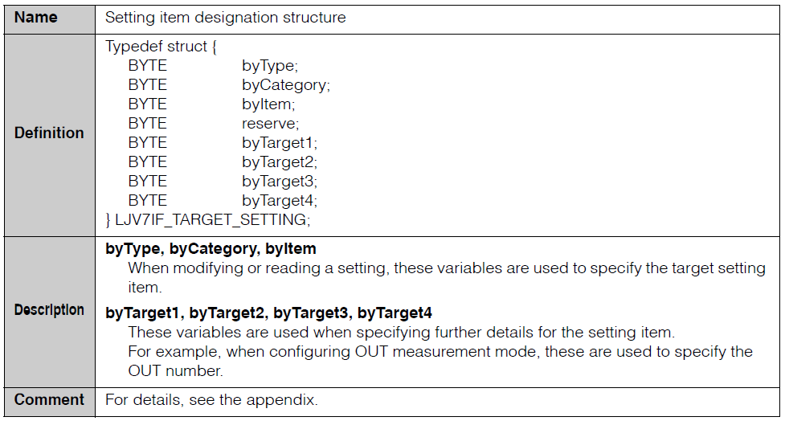
The Important Struct
Note how these line up with the variables shown in Slide 5
Pg. 11

Slide 8
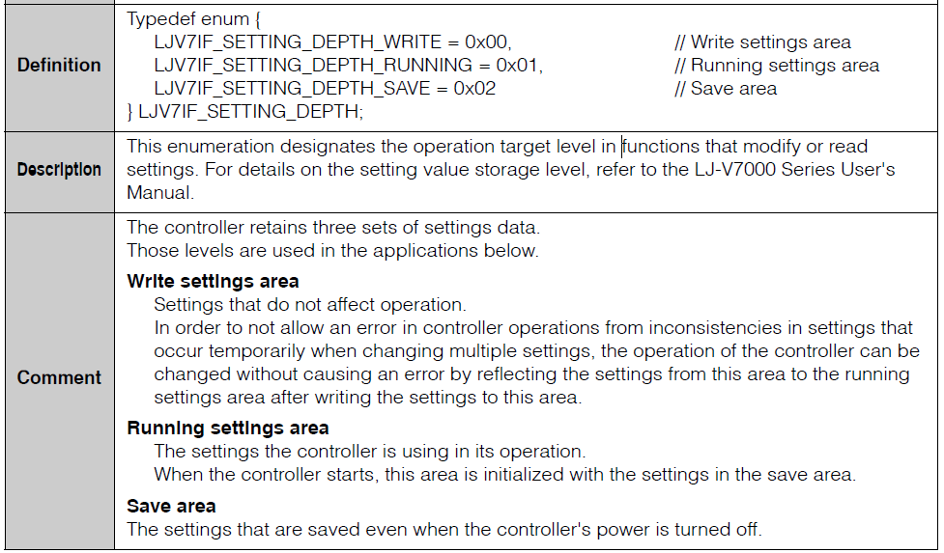
Understanding The Layout
Pg. 7
[1] is the setting depth which is defined above.
Typically when getting settings, 0x01 is used as it is the currently running configuration.

Slide 9
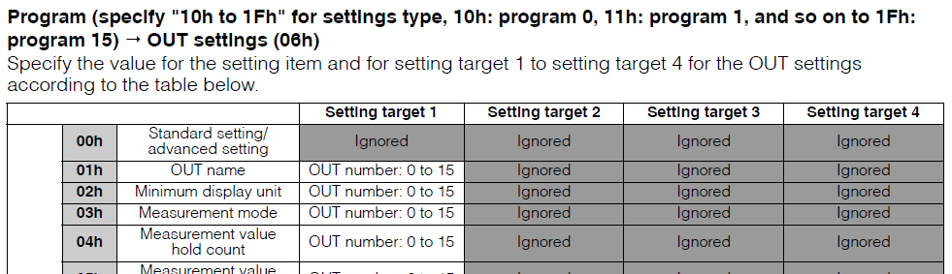
Understanding The Layout
Pg. 72
[2] is the setting type which is which program to read/write to.
We want to read from program 0 so we entered 0x10
[3] defines which category to read/write from.
We will use 0x06 which is the “OUT Settings” category
[4] defines the specific item to get/set.
We will use 0x03 because we wish to obtain the measurement mode.
[5] defines which output to get/set the parameters.
We will use 0x00 because we wish to get the measurement mode of OUT 0 from Program 0

Slide 10
Understanding the Layout
The results were:
03 01 00 00
Byte 1 > 03 > 0.001mm as the Minimum display unit
Byte 2 > 01 > Height measurement mode
Byte 3-4 > Reserved
Pg. 72

Slide 11
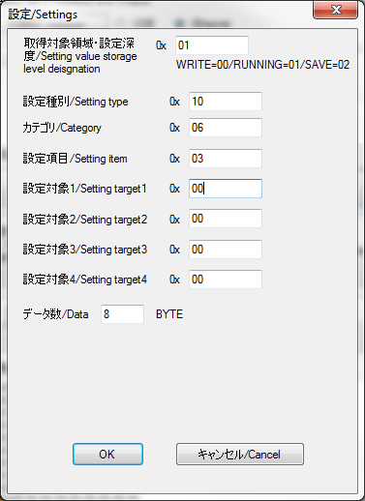
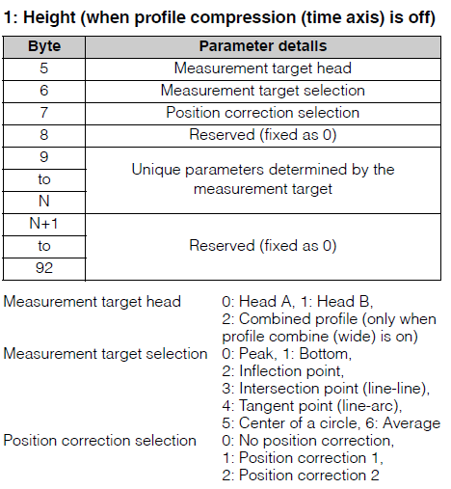

Getting Additional Information
Pg. 73
We simply asked for more data back which included additional information about the height measurement.

Slide 12
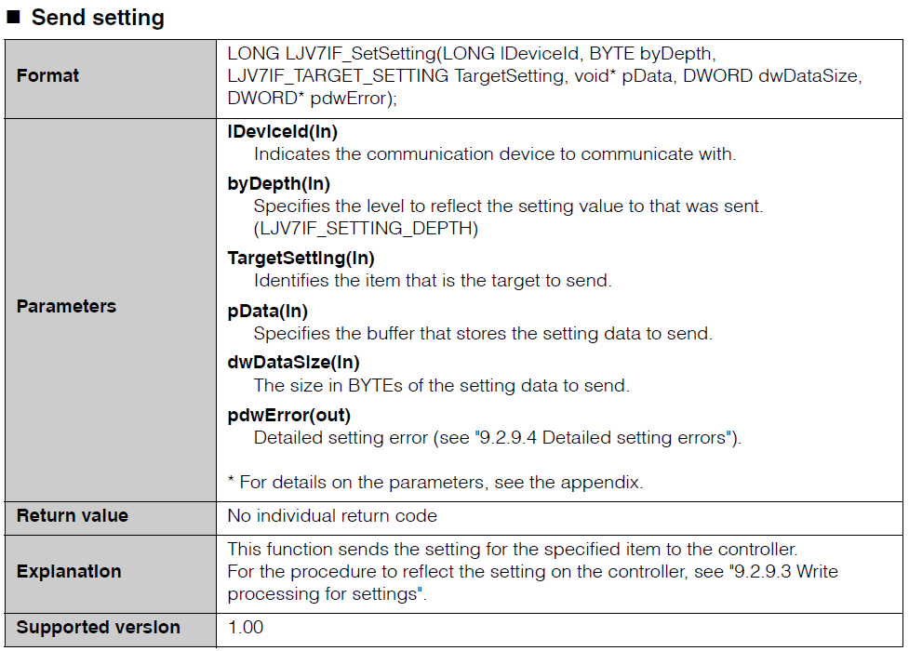
Changing Settings
You’ll notice it is many of the same parameters as discussed before.
Pg. 32

Slide 13
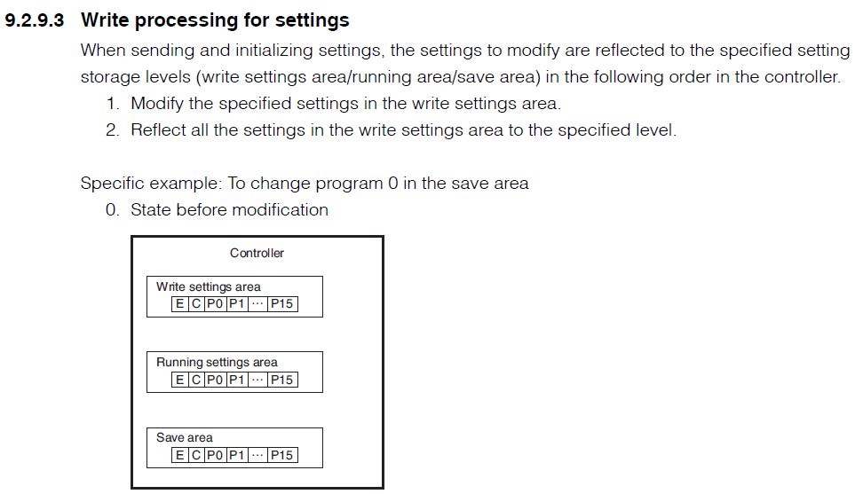
Changing Measurement Target
Pg. 49
Using this method ensures that the settings will be persistent through power cycles.

Slide 14
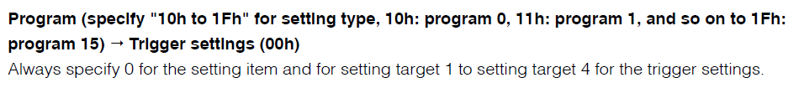
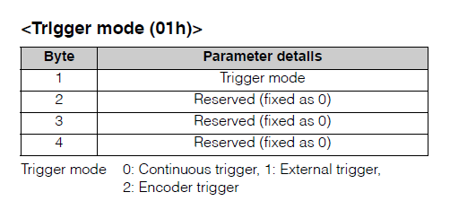
Changing Measurement Target
Pg. 62
For the sake of simplicity here, we will change the trigger mode to “External Trigger”
Setting Depth: 0x00
Setting Type: 0x10
Category: 0x00
Setting Item: 0x01
Setting Target 1: 0x00
Setting Target 2: 0x00
Setting Target 3: 0x00
Setting Target 4: 0x00
Buffer size: 1 byte
Data: 0x01
Or
Buffer size: 4 byte
Data: 0x01,0x00,0x00,0x00

Slide 15
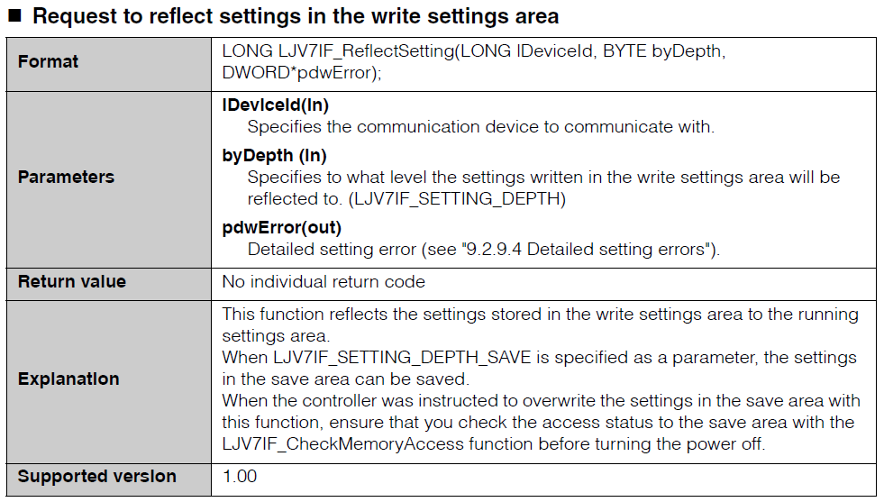
Reflect Settings From Write Area
Pg. 34

